Slide 1
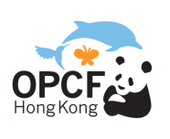
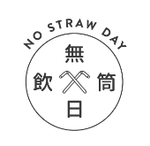
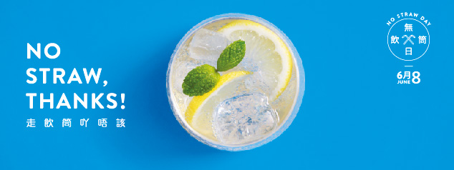
全城走飲筒 No straw, thanks!

Slide 2
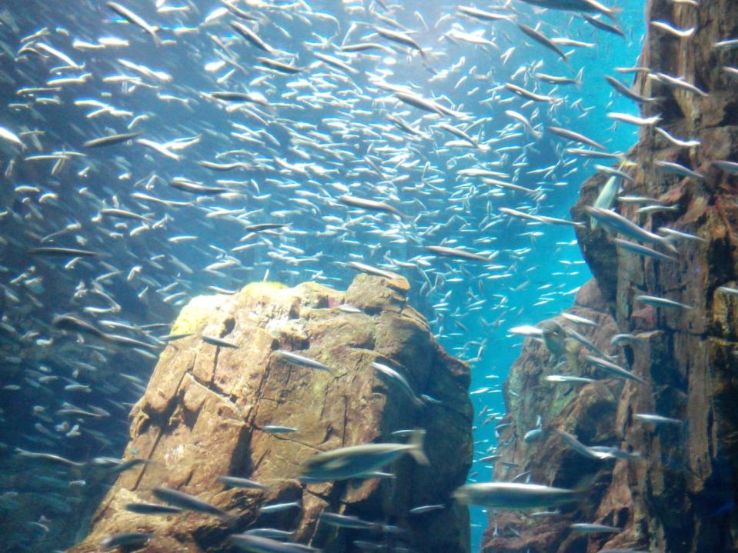
我們 海洋?
能沒有
Can We Live Without the Oceans?

Slide 3
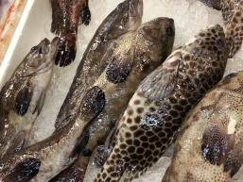
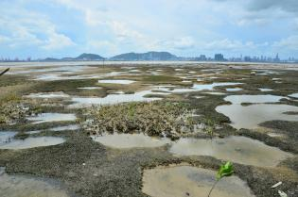
海洋提供給我們的生態服務
Eco-services provided by the oceans
還有甚麼?
Any more?
供應食物
Food provider
大氣層的調節
Regulation of the
atmosphere

Slide 4
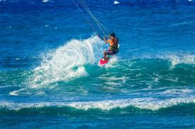
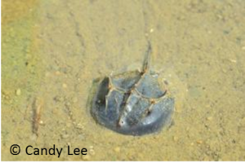
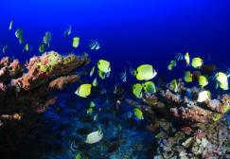
水上活動
Aquatic activities
發現/尚未發現物種之醫療價值
Medical of the discovered/ the not yet discovered species
美麗的海洋生物的棲息地
Habitat of beautiful aquatic organisms

Slide 5
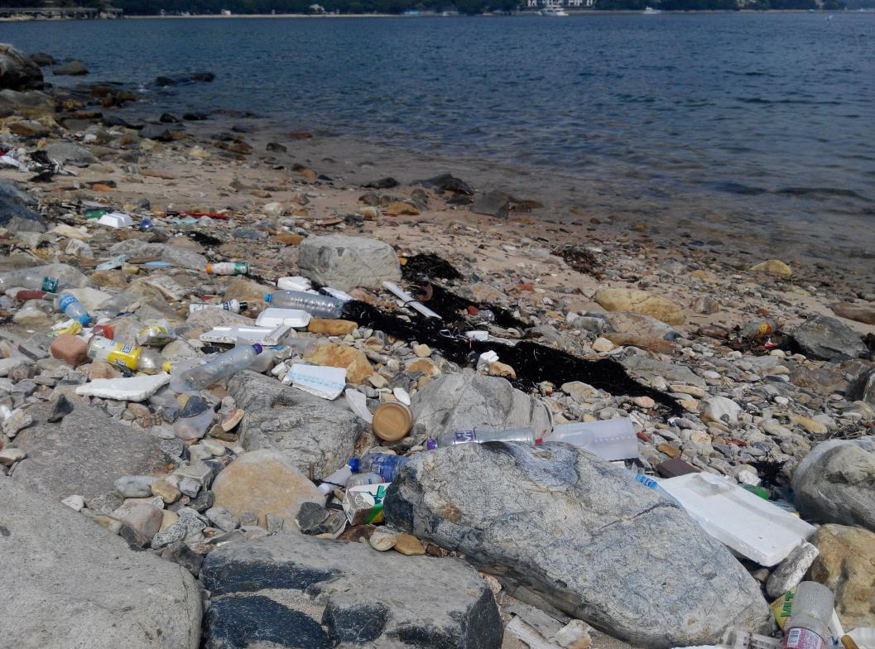
海
活在
?
垃圾
Living in the ocean ?
of trash

Slide 6
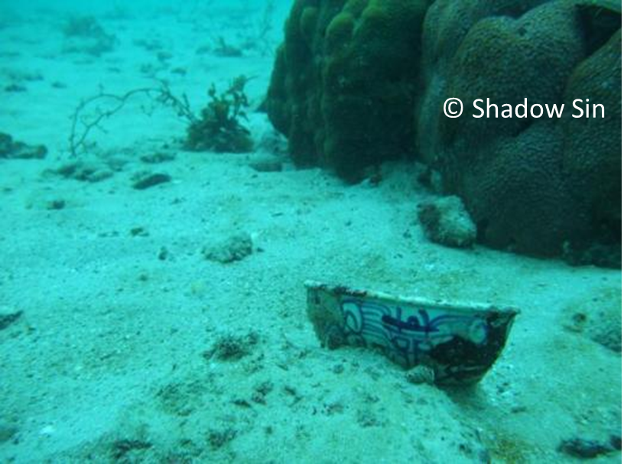
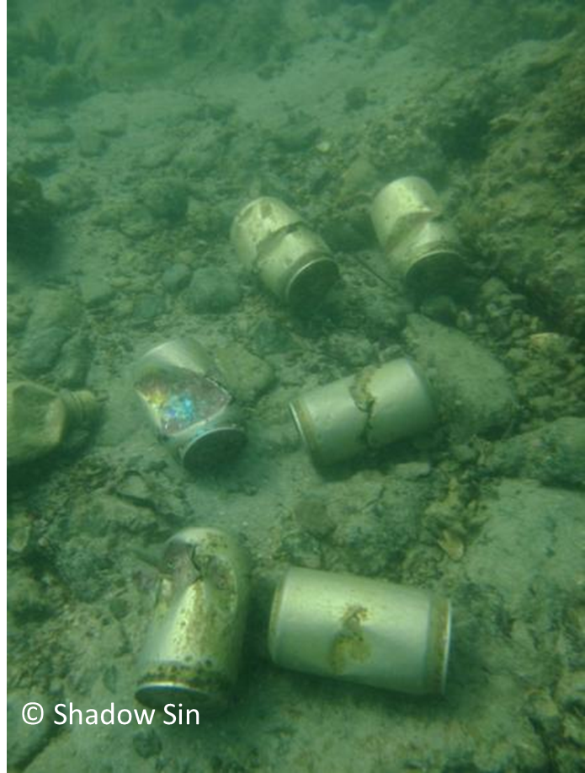
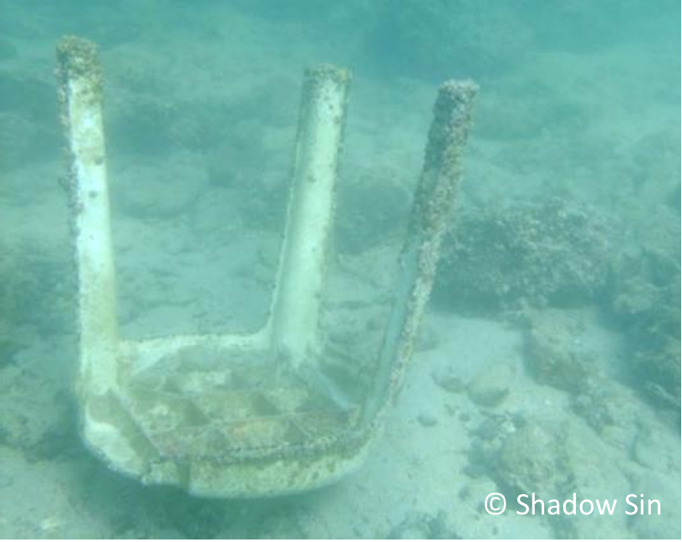
海洋垃圾 Marine debris

Slide 7
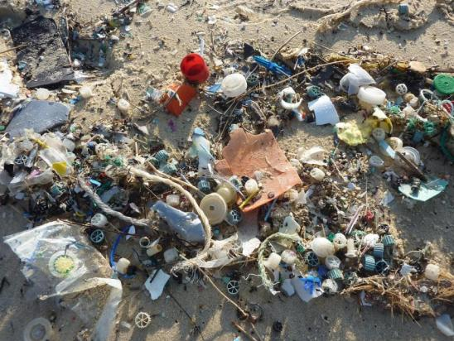
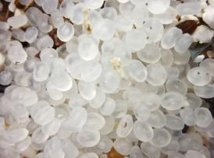
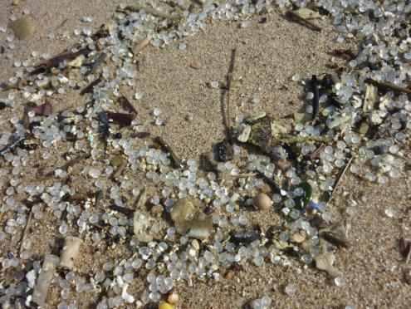
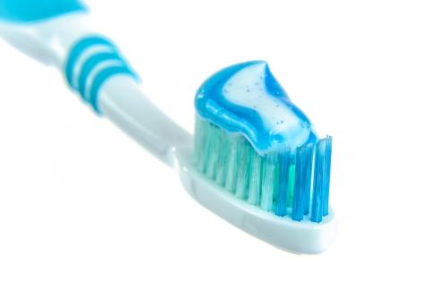
微膠粒
Microbeads/microplastics

Slide 8
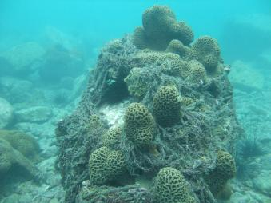
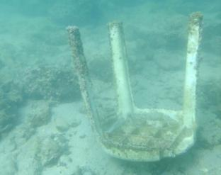
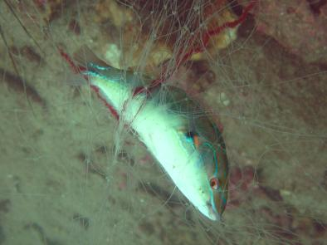
海洋垃圾問題有多嚴重?
How serious is the marine debris issue now?
全球性 Globally
香港 HK
The Great Pacific Garbage Patch
Lap Sap Wan
VS

Slide 9
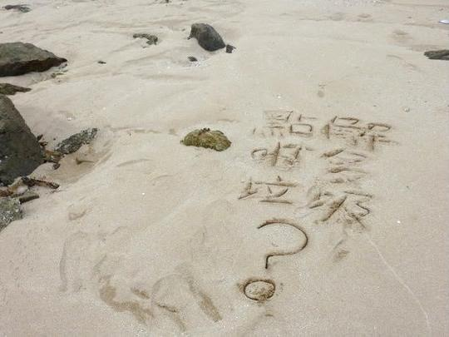
Why is there so much trash?
點
解
?

Slide 10
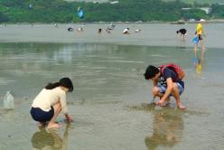
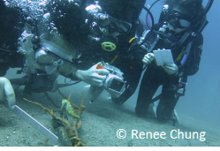
海洋垃圾的來源 Sources of marine debris
來自海上活動 Sea-based
20-40%
60-80%
來自陸上活動 Land-based

Slide 11
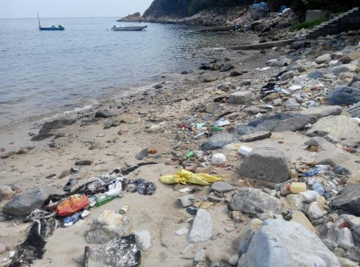
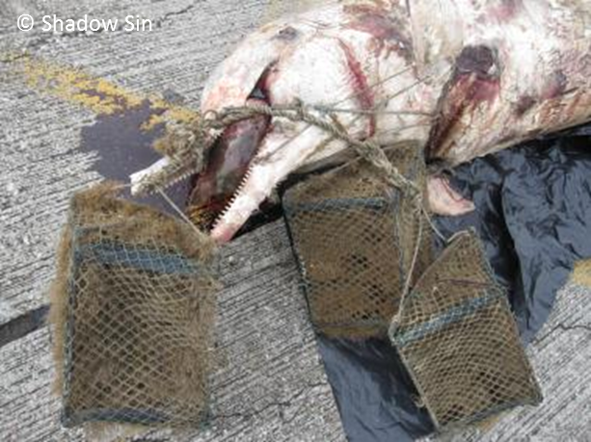
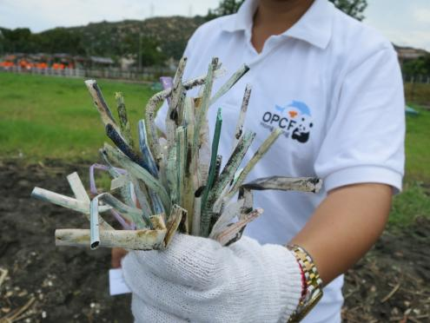
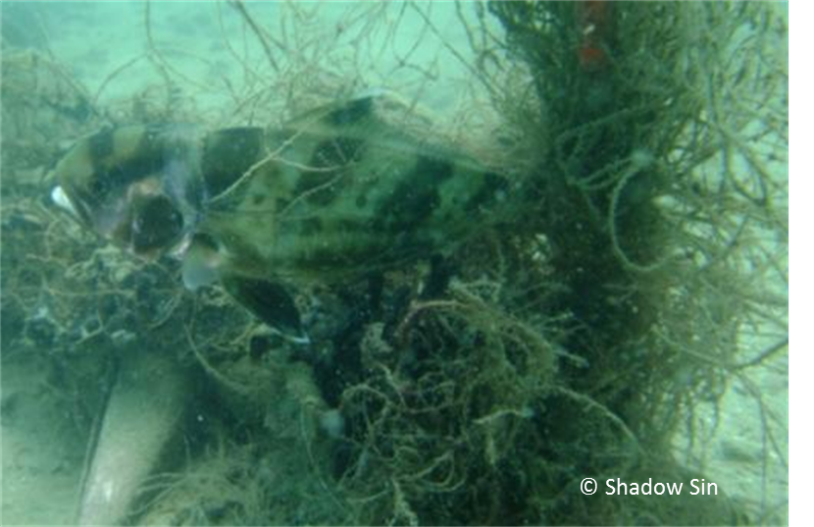
對環境的禍害 Impacts on the environment
在海龜腸胃裏發現的漁網
Fishing net found in intestine in sea turtle
被5個漁籠纏繞而溺死的中華白海豚
Chinese white dolphin got entangled by 5 fish cages and drowned

Slide 12
解決問題
Tackling the problem
清潔海岸
Clean
Shorelines
育養海岸
Coastal Watch

Slide 13
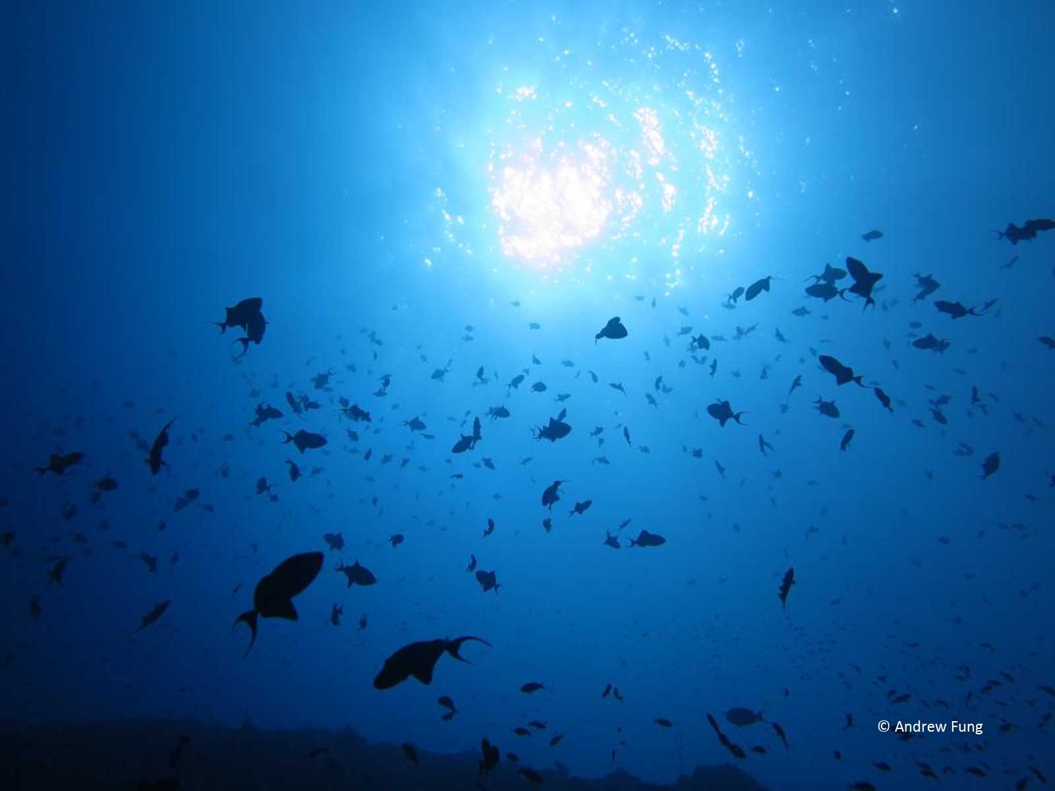
Save
our oceans 海洋
拯救
ourselves 我們

Slide 14
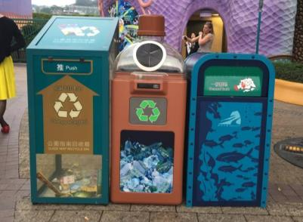
拯救海洋 拯救自己 – 你還不行動嗎？
The future of our oceans is in our hands – What are you waiting for?
5R: 減少、重用、替代、維修、回收
5R: Reduce, Reuse, Replace, Repair, Recycle
減少使用塑膠及即棄產品
Less plastic and disposable items
實踐乾淨回收
Practice GREEN recycling
Notes:
https://www.everydayhealth.com.tw/article/10750

Slide 15
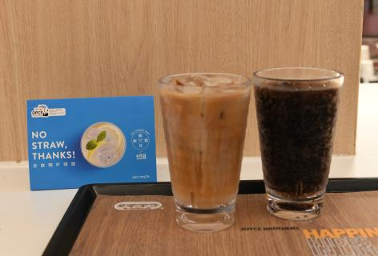
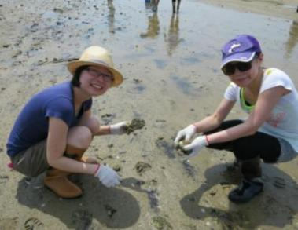
拯救海洋 拯救自己 – 你還不行動嗎？
The future of our oceans is in our hands – What are you waiting for?
走飲筒吖唔該！ No straw, thanks!
泥灘 / 海岸清潔活動 Mudflats / Coastal Clean-up

